Slide 1


ARTIFICIAL INTELLIGENCE PRESENTS
Smart Parking
SYSTEM

Slide 2
Presented By :
Krishna Shrivastava (RA2111026010399)
Gracy Arora (RA2111026010390)
AKshat Jain (RA2111026010404)

Slide 3
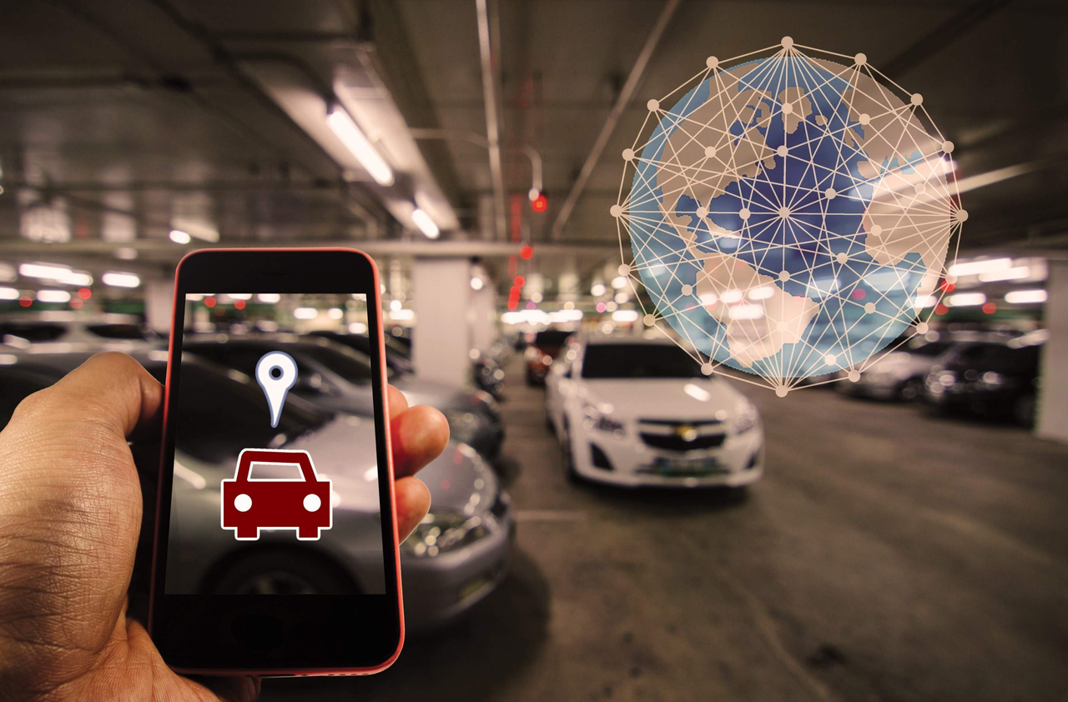
Introduction to Smart Parking System
A smart parking system is an advanced technological solution designed to efficiently manage parking spaces in urban or crowded areas, various components like sensors, cameras, and mobile applications to efficiently manage parking spaces. It employs AI algorithms to analyze data in real-time, predicting parking availability and guiding drivers to vacant spots. This technology optimizes urban mobility, reduces environmental impact, and enhances economic activity by streamlining parking processes.

Slide 4
the significance of efficient parking management in urban areas
Reduces traffic congestion by minimizing search time for parking.
Optimizes land use by efficiently utilizing available space.
Boosts economic activity by facilitating easy access to businesses and attractions.
Improves air quality by reducing vehicle idling and emissions.
Enhances mobility and inclusivity with designated parking spaces.
Reduces environmental impact by minimizing unnecessary vehicle emissions.
Elevates quality of life by reducing stress and frustration associated with parking.

Slide 5
Basic Overview
Predicting Parking Availability: Analyzing real-time inputs to forecast parking space availability, guiding drivers to vacant spots.
Dynamic Pricing: Adjusting parking fees based on demand, encouraging turnover in high-traffic areas and maximizing revenue.
Space Allocation: Optimizing parking space allocation by analyzing usage patterns, adjusting designated areas for different vehicle sizes or purposes.
Traffic Flow Management: Using real-time data to direct drivers to available parking spaces efficiently, reducing congestion and improving traffic flow.
Maintenance Prediction: Predicting maintenance needs for parking infrastructure based on usage patterns and environmental factors, optimizing maintenance schedules and reducing downtime.

Slide 6

COMPONENTS OF SMART PARKING SYSTEMS:
1) HARDWARE COMPONENTS
2)SOFTWARE COMPONENTS

Slide 7
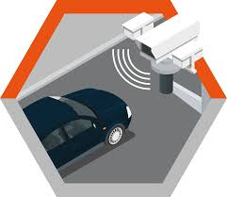
Cameras:
Cameras are strategically placed to capture visual data of parking areas, providing additional information to complement sensor data.
They can be used for license plate recognition, vehicle counting, and monitoring parking lot occupancy.
Image data from cameras is processed by AI algorithms to extract relevant information and enhance parking management capabilities.
HARDWARE
COMPONENTS

Slide 8
SOFTWARE COMPONENTS
AI Algorithms (YOLO V8)
Data Analytics
Mobile Applications

Slide 9
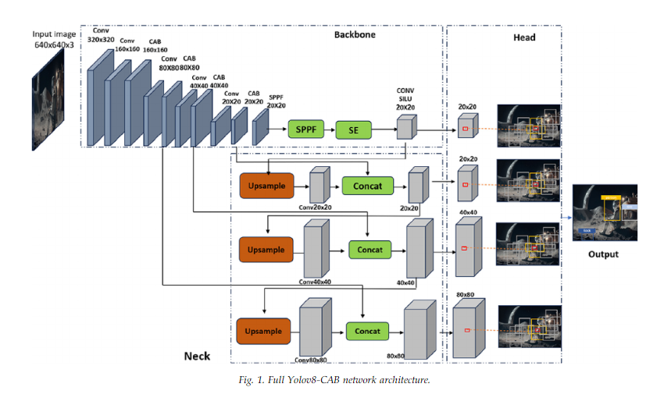
AI MODEL
YOLO V8
In a smart parking system, YOLO V8 (You Only Look Once version 8) plays a crucial role in vehicle detection and classification. YOLO V8 is an advanced object detection algorithm that processes video feeds or image data from cameras in real-time. It accurately identifies vehicles within parking spaces with high speed and precision.

Slide 10
Here's how YOLO V8 is utilized in a smart parking system:
Vehicle Detection: YOLO V8 scans the video feed or image data captured by cameras installed in the parking facility. It identifies the presence of vehicles within parking spaces, accurately detecting their locations.
Classification: YOLO V8 classifies the detected vehicles based on predefined categories, such as car, truck, motorcycle, or bicycle. This classification helps in understanding the types of vehicles occupying parking spaces.
Occupancy Monitoring: By continuously analyzing the video feed, YOLO V8 monitors parking space occupancy in real-time. It detects when vehicles enter or leave parking spaces, providing up-to-date information on space availability.
Counting of free parking spaces - The predefines areas where the parking spaces are and if that area does not have a car it will be counted as a free parking space.

Slide 11
Working
YOLO V8
YOLO v8’s Working Principle
YOLO v8 builds on the core YOLO concept developed by Ultralytics, further refining it for optimal performance. In essence, YOLO v8 works by dividing the input image into a grid, typically with a size of 13x13 or 26x26, depending on the specific type. Each grid cell takes responsibility for predicting objects within its spatial domain. Following are the basic steps of the working principle of YOLO v8:

Slide 12
1. Input Processing: YOLO v8 takes an image as input and divides it into a grid, typically with a size of 13x13 or 26x26, depending on the specific type. Each grid cell is responsible for predicting objects within its spatial domain.
2. Feature Extraction: The network extracts high-level features from the input image using a deep convolutional neural network (CNN). The choice of the network architecture often taken from established models like ResNeXt or Darknet.
3. Bounding Box Prediction: YOLO v8 predicts the bounding box for objects by regressing the coordinates of the top-left corner, width and height of the box. Additionally, it calculates a confidence score that indicates the probability that the predicted box contains the object.
4. Class Prediction: Along with bounding box predictions, YOLO v8 also predicts class probabilities for each grid cell. This means that the model can not only detect objects but also identify their relative categories.
5. Post-Processing: Once the predictions are made, a confidence threshold is applied to filter out low-confidence detections. Non-maximum suppression is then used to remove duplicate or overlapping bounding boxes, ensuring that only the most accurate search continues.

Slide 13
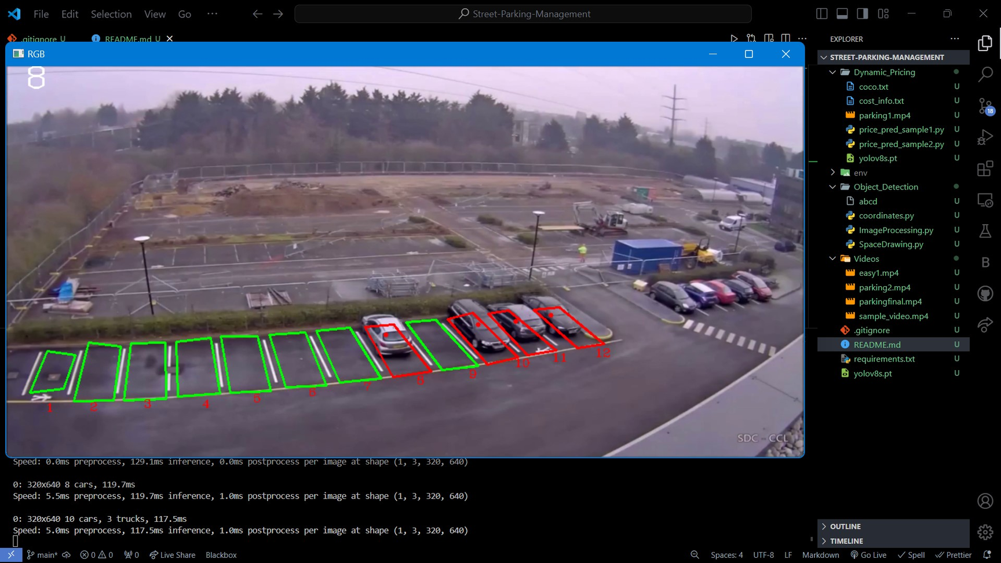
oUTPUT OF THE MODEL

Slide 14
THANK YOU

